Slide 1
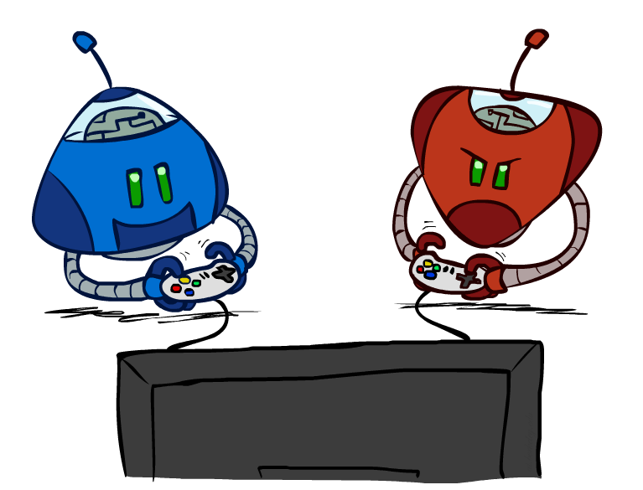
CS 4/526: Artificial Intelligence
Adversarial Search
Instructor: Jared Saia
University of New Mexico,
[These slides adapted from Dan Klein and Pieter Abbeel]
Notes:
Please retain proper attribution, including the reference to ai.berkeley.edu. Thanks!

Slide 2
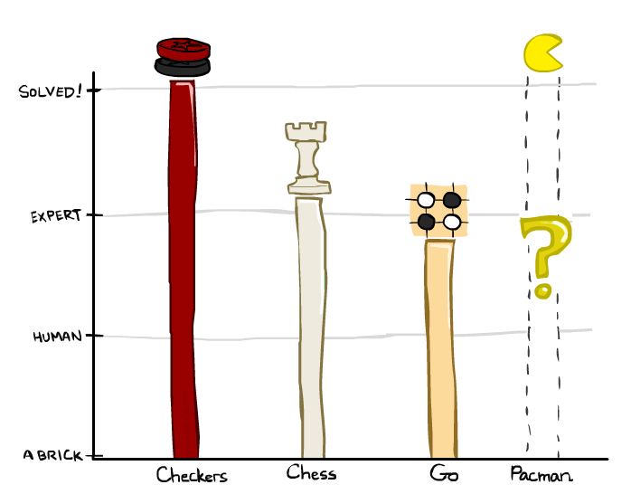
Game Playing State-of-the-Art
Checkers: 1950: First computer player. 1994: First computer champion: Chinook ended 40-year-reign of human champion Marion Tinsley using complete 8-piece endgame. 2007: Checkers solved!
Chess: 1997: Deep Blue defeats human champion Gary Kasparov in a six-game match. Deep Blue examined 200M positions per second, used very sophisticated evaluation and undisclosed methods for extending some lines of search up to 40 ply. Current programs are even better, if less historic.
Go: 2016: Alpha Go defeats Lee Sedol (world champion). 2017: AlphaZero crushes Alpha Go (and other computer systems at Go, Shogi and chess). AlphaZero was trained solely via self-play using deep learning.

Slide 3

Game Playing State-of-the-Art
Checkers: 1950: First computer player. 1994: First computer champion: Chinook ended 40-year-reign of human champion Marion Tinsley using complete 8-piece endgame. 2007: Checkers solved!
Chess: 1997: Deep Blue defeats human champion Gary Kasparov in a six-game match. Deep Blue examined 200M positions per second, used very sophisticated evaluation and undisclosed methods for extending some lines of search up to 40 ply. Current programs are even better, if less historic.
Go: 2016: Alpha Go defeats Lee Sedol (world champion). 2017: AlphaZero crushes Alpha Go (and other computer systems at Go, Shogi and chess). AlphaZero was trained solely via self-play using deep learning.

Slide 4

Behavior from Computation
[Demo: mystery pacman (L6D1)]

Slide 5

Video of Demo Mystery Pacman

Slide 6
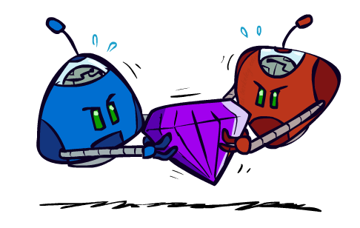
Adversarial Games

Slide 7
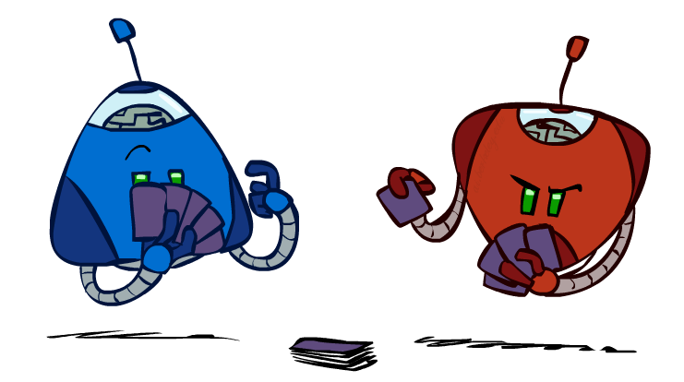
Types of Games
Many different kinds of games!
Axes:
  Deterministic or stochastic?
  One, two, or more players?
  Zero sum?
  Perfect information (can you see the state)?

Slide 8
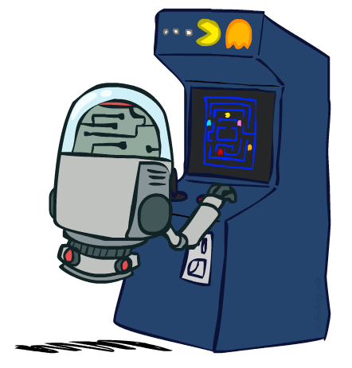
Deterministic Games
Many possible formalizations, one is:
  States: S (start at s₀)
  Players: P={1...N} (usually take turns)
  Actions: A (may depend on player / state)
  Transition Function: SxA → S
  Terminal Test: S → {t,f}
  Terminal Utilities: SxP → R
Solution for a player is a policy: S → A

Slide 9
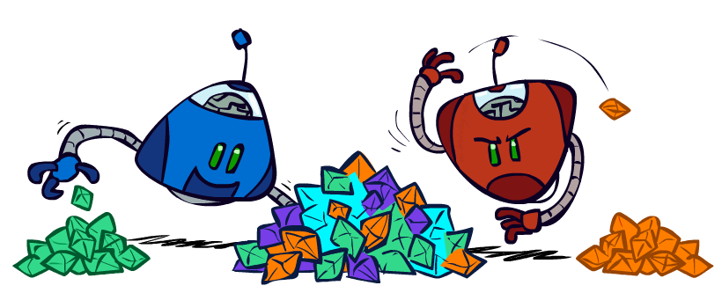
Zero-Sum Games
Zero-Sum Games
  Agents have opposite utilities (values on outcomes)
  Lets us think of a single value that one maximizes and the other minimizes
  Adversarial, pure competition
General Games
  Agents have independent utilities (values on outcomes)
  Cooperation, indifference, competition, and more are all possible
  More later on non-zero-sum games

Slide 10
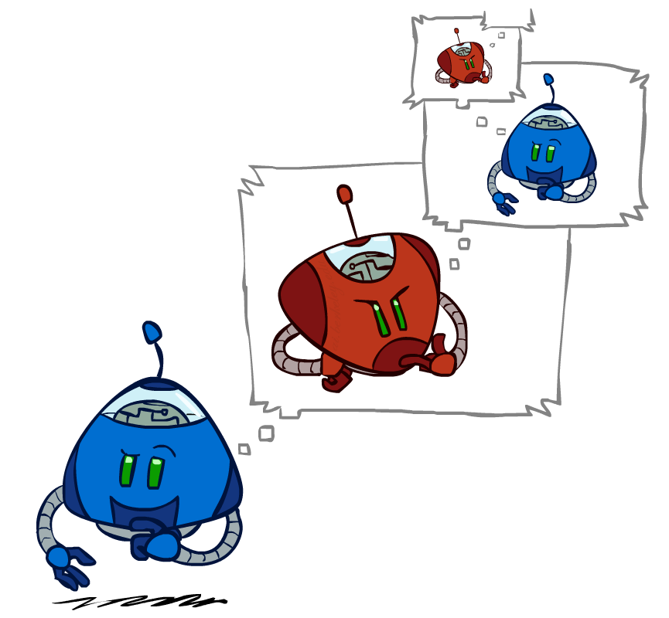
Adversarial Search

Slide 11
4/527 News: Cost -> Utility!
no longer minimizing cost!
agent now wants to maximize its score/utility!

Slide 12
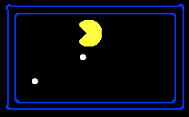
Single-Agent Trees
8
2
0
…
2
6
…
4
6

Slide 13
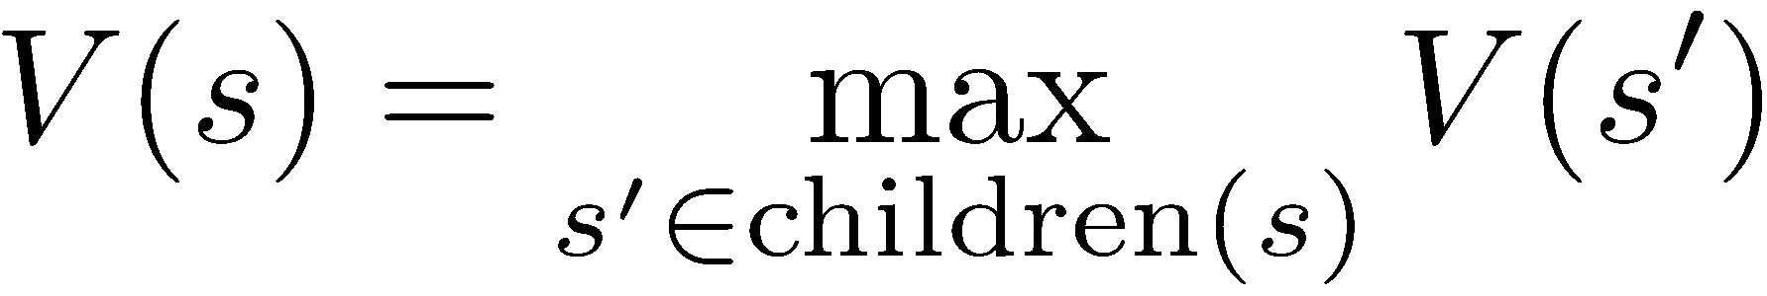
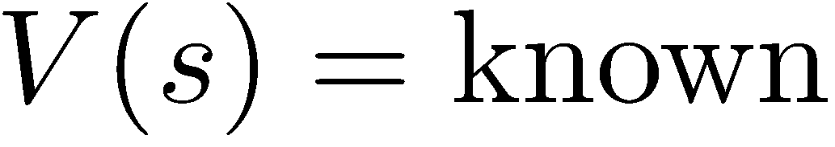
Value of a State
Value of a state: The best achievable outcome (utility) from that state
Non-Terminal States:
8
2
0
…
2
6
…
4
6
Terminal States:

Slide 14

Adversarial Game Trees
-20
-8
…
-18
-5
…
-10
+4
-20
+8

Slide 15
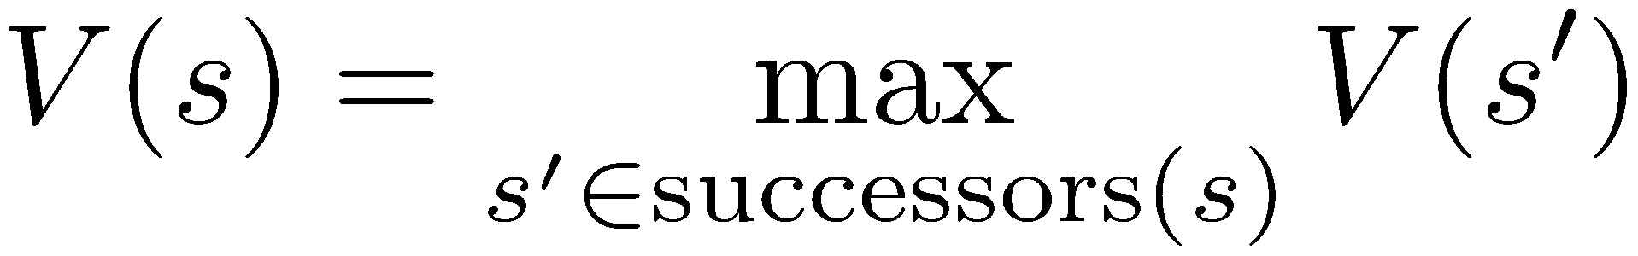
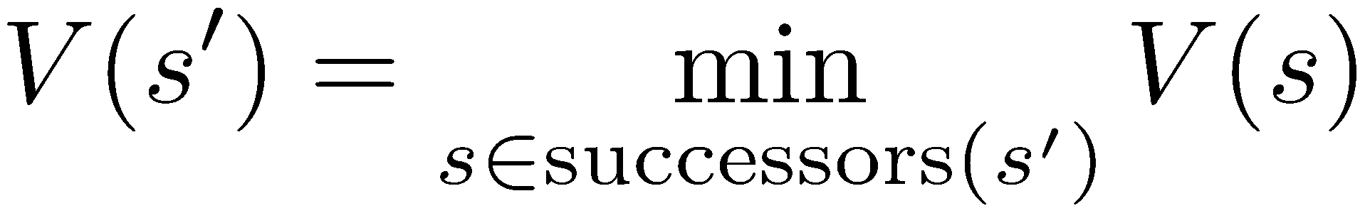
Minimax Values
States Under Agent’s Control:
States Under Opponent’s Control:
-8
-5
-10
+8
Terminal States:

Slide 16

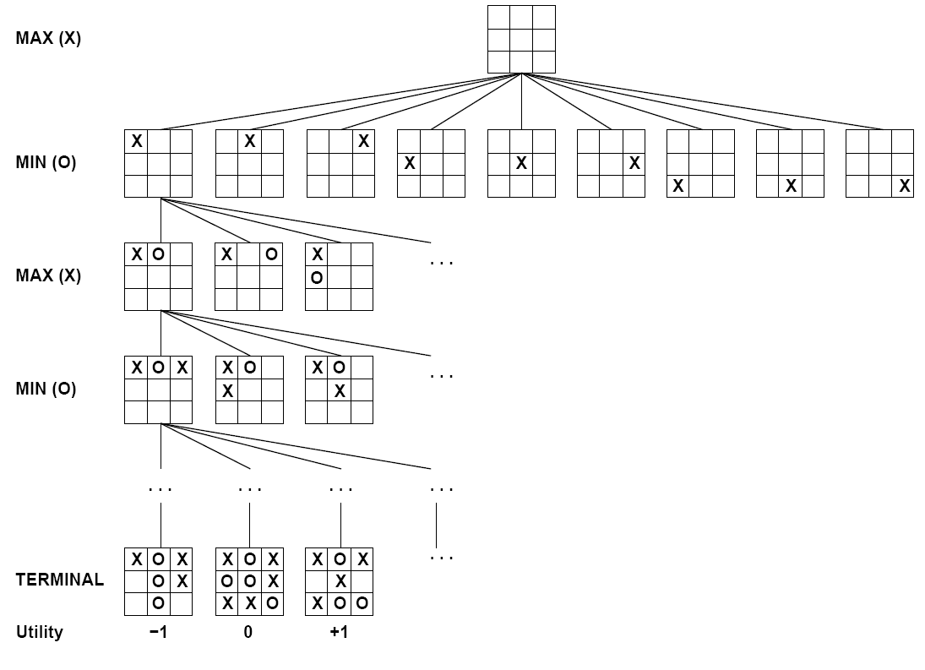

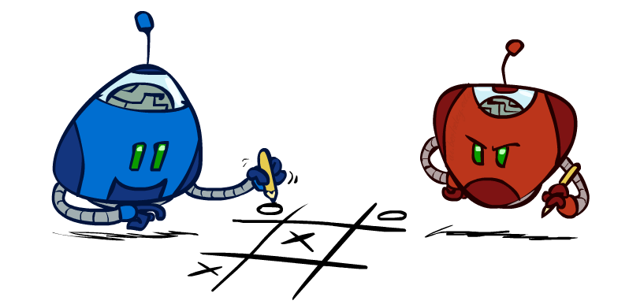
Tic-Tac-Toe Game Tree

Slide 17
Adversarial Search (Minimax)
Deterministic, zero-sum games:
  Tic-tac-toe, chess, checkers
  One player maximizes result
  The other minimizes result
Minimax search:
  A state-space search tree
  Players alternate turns
  Compute each node’s minimax value: the best achievable utility against a rational (optimal) adversary
Minimax values:
computed recursively
5
max
2
5
min
8
2
5
6
Terminal values:
part of the game

Slide 18
Minimax Implementation
def max-value(state):
  initialize v = -∞
  for each successor of state:
    v = max(v, min-value(successor))
  return v
def min-value(state):
  initialize v = +∞
  for each successor of state:
    v = min(v, max-value(successor))
  return v

Slide 19
Minimax Implementation (Dispatch)
def value(state):
  if the state is a terminal state: return the state’s utility
  if the next agent is MAX: return max-value(state)
  if the next agent is MIN: return min-value(state)
def max-value(state):
  initialize v = -∞
  for each successor of state:
    v = max(v, value(successor))
  return v
def min-value(state):
  initialize v = +∞
  for each successor of state:
    v = min(v, value(successor))
  return v
Notes:
Pick an order for two reasons: sequential processor and pruning

Slide 20
Minimax Example
3
12
8
2
4
6
14
5
2

Slide 21
Minimax Efficiency
How efficient is minimax?
  Just like (exhaustive) DFS
  Time: O(b^{m})
  Space: O(bm)
Example: For chess, b ≈ 35, m ≈ 100
  Exact solution is completely infeasible
  But, do we need to explore the whole tree?

Slide 22
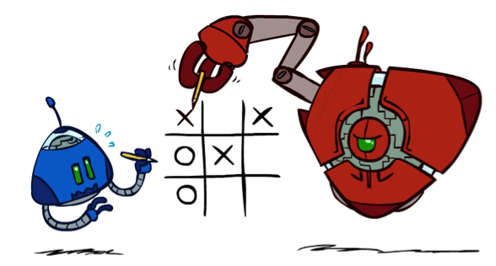
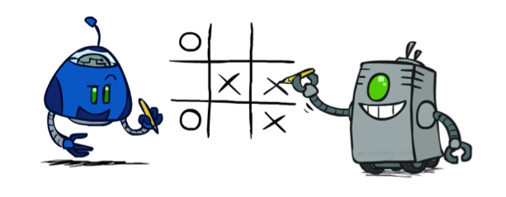
Minimax Properties
max
min
10
10
9
100
Optimal against a perfect player. Otherwise?
[Demo: min vs exp (L6D2, L6D3)]
Notes:
correct against evil mastermind

Slide 23
Video of Demo Min vs. Exp (Min)

Slide 24
Video of Demo Min vs. Exp (Exp)

Slide 25

Resource Limits

Slide 26
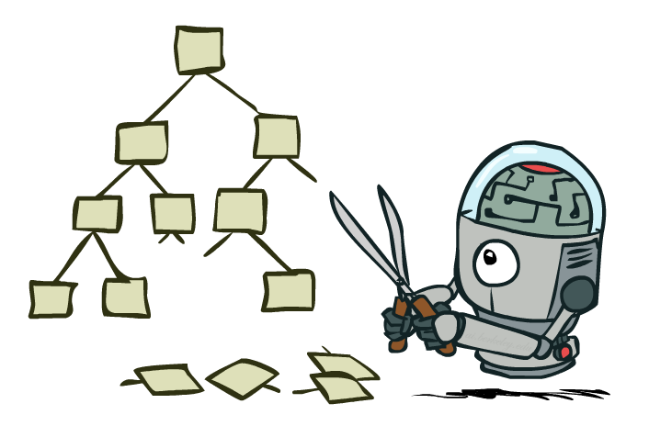
Game Tree Pruning

Slide 27
Minimax Example
3
12
8
2
4
6
14
5
2

Slide 28
Minimax Pruning
3
12
8
2
14
5
2

Slide 29
Alpha-Beta Pruning
General configuration (MIN version)
  We’re computing the MIN-VALUE at some node n
  We’re looping over n’s children
  n’s estimate of the childrens’ min is dropping
  Who cares about n’s value? MAX
  Let a be the best value that MAX can get at any choice point along the current path from the root
  If n becomes worse than a, MAX will avoid it, so we can stop considering n’s other children (it’s already bad enough that it won’t be played)
MAX version is symmetric
MAX
MIN
a
MAX
MIN
n

Slide 30
Alpha-Beta Implementation
  α: MAX’s best option on path to root
  β: MIN’s best option on path to root
def max-value(state, α, β):
  initialize v = -∞
  for each successor of state:
    v = max(v, value(successor, α, β))
    if v ≥ β return v
    α = max(α, v)
  return v
def min-value(state , α, β):
  initialize v = +∞
  for each successor of state:
    v = min(v, value(successor, α, β))
    if v ≤ α return v
    β = min(β, v)
  return v
Notes:
Pick an order for two reasons: sequential processor and pruning

Slide 31
Alpha-Beta Pruning Properties
This pruning has no effect on minimax value computed for the root!
Values of intermediate nodes might be wrong
  Important: children of the root may have the wrong value
  So the most naïve version won’t let you do action selection
Good child ordering improves effectiveness of pruning
With “perfect ordering”:
  Time complexity drops to O(b^{m/2})
  Doubles solvable depth!
  Full search of, e.g. chess, is still hopeless…
This is a simple example of metareasoning (computing about what to compute)
max
min
10
10
0

Slide 32
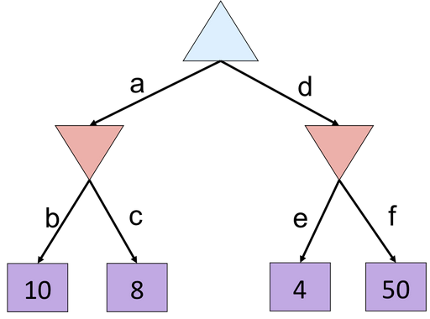
Alpha-Beta Quiz

Slide 33
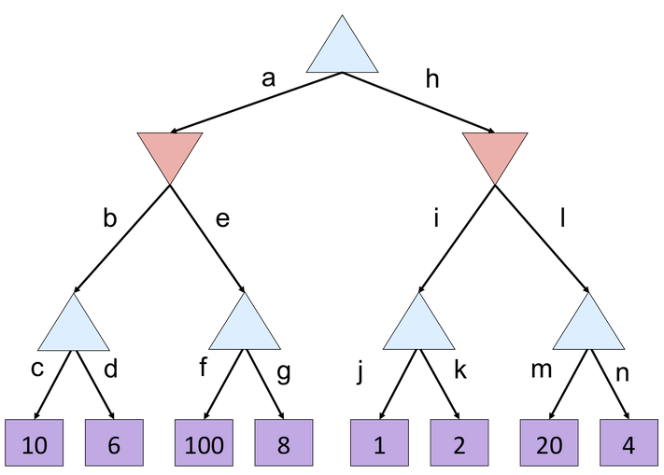
Alpha-Beta Quiz 2

Slide 34
Resource Limits

Slide 35
Resource Limits
Problem: In realistic games, cannot search to leaves!
Solution: Depth-limited search
  Instead, search only to a limited depth in the tree
  Replace terminal utilities with an evaluation function for non-terminal positions
Example:
  Suppose we have 100 seconds, can explore 10K nodes / sec
  So can check 1M nodes per move
  α-β reaches about depth 8 – decent chess program
Guarantee of optimal play is gone
More plies makes a BIG difference
Use iterative deepening for an anytime algorithm
max
4
-2
4
min
-1
-2
4
9
?
?
?
?

Slide 36
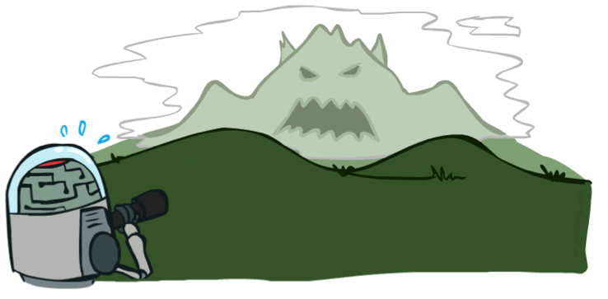

Depth Matters
Evaluation functions are always imperfect
The deeper in the tree the evaluation function is buried, the less the quality of the evaluation function matters
An important example of the tradeoff between complexity of features and complexity of computation
[Demo: depth limited (L6D4, L6D5)]

Slide 37
Video of Demo Limited Depth (2)

Slide 38
Video of Demo Limited Depth (10)

Slide 39
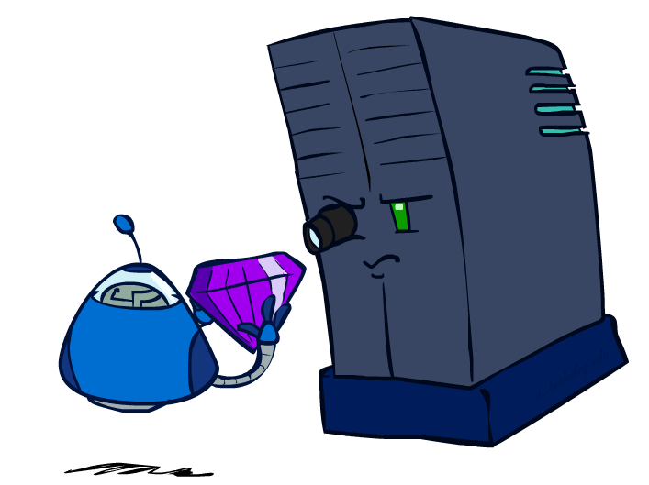
Evaluation Functions

Slide 40
Evaluation Functions
Evaluation functions score non-terminals in depth-limited search
Ideal function: returns the actual minimax value of the position
In practice: typically weighted linear sum of features:
e.g. f₁(s) = (num white queens – num black queens), etc.

Slide 41




Evaluation for Pacman
[Demo: thrashing d=2, thrashing d=2 (fixed evaluation function), smart ghosts coordinate (L6D6,7,8,10)]

Slide 42
Video of Demo Thrashing (d=2)

Slide 43
Why Pacman Starves
A danger of replanning agents!
  He knows his score will go up by eating the dot now (west, east)
  He knows his score will go up just as much by eating the dot later (east, west)
  There are no point-scoring opportunities after eating the dot (within the horizon, two here)
  Therefore, waiting seems just as good as eating: he may go east, then back west in the next round of replanning!

Slide 44
Video of Demo Thrashing -- Fixed (d=2)

Slide 45
Video of Demo Smart Ghosts (Coordination)

Slide 46
Video of Demo Smart Ghosts (Coordination) – Zoomed In

Slide 47
Next Time: Uncertainty!

Slide 48
Iterative Deepening
Iterative deepening uses DFS as a subroutine:
Do a DFS which only searches for paths of length 1 or less. (DFS gives up on any path of length 2)
If “1” failed, do a DFS which only searches paths of length 2 or less.
If “2” failed, do a DFS which only searches paths of length 3 or less.
….and so on.
Why do we want to do this for multiplayer games?
Note: wrongness of eval functions matters less and less the deeper the search goes!
b
…

