Slide 1
CS-150 Computing for Business Students Final Exam Review
Instructor:
Matthew Barrick
e-mail: barrick@cs.unm.edu
www.cs.unm.edu/~barrick
Office: Farris Engineering Center (FEC) room 106

Slide 2
Schedule
Dec 1 – Final Exam Review (Bring your Questions) Lab 11 this week during Lab
Dec 6 – Final Exam During Labs No Lecture
Dec 5, 11:59 PM Lab 11 Due
Dec 11, 11:59 PM Last Day Labs accepted, Lab 12 Due
Dec 8, No Lecture (just the exam during Lab)

Slide 3
Lab 12 – PowerPoint
Due Dec 11, 11:59 PM
No Lecture on PowerPoint
Optional
You choose to do it, it counts for 200 points (instead of the normal 100 points) and your lab grade will be out of 1300 (as opposed to 1100).
Note that do to the due date, you can’t hand this in late.
Last Semester’s Slides on my website what they are worth without my witty narrative.

Slide 4
Final Exam Format
Same as Midterm in terms of how you will take
Note that your one sheet must be a 8.5x11” piece of paper with hand-written notes only
Remember that if you need to take it during a different Lab Period to prearrange with that Instructor (that doesn’t mean speak with them 5 minutes before Lab Period)

Slide 5
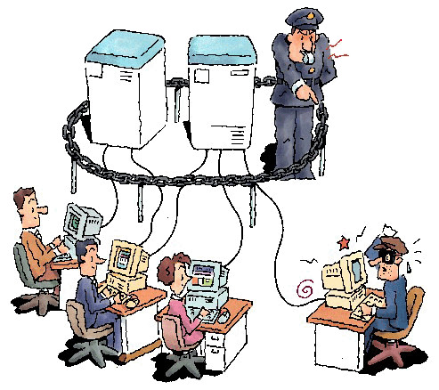
Excel Exam: Next week
During your regular lab class.
Must use Lab Windows XP computer with Excel 2007
I will check ITS internet usage logs for DSH 141 at the end of the week.
This does not include layer 3 information (user data packets), but does include IP addresses.

Slide 6
Excel Exam: Next week
Must use Lab Windows XP computer with Excel 2007
That means Mac users should practice on Lab Machines!
Yes, we actually do this!
I will check ITS internet usage logs for DSH 141 at the end of the week.

Slide 7
Excel Exam: Next week
Section 9 and 10 (a.k.a You) have 75 minute labs
The exam takes 50 minutes
As a courtesy to those that might have traffic/parking problems and for those last minute questions, the exam will begin 10 minutes into the lab.
Don’t plan on being late! But don’t worry if you are normally a little late that you will have a big problem

Slide 8
Excel Exam: Next week
You need to print your exams
Factor in time for printing (sometimes there is a line)
Make sure you have money on your card (some extra in case of problems never hurts, $1.00 should be more than enough).
If you have not used the lab printing system, use it before exam day. It’s not hard to use, but you don’t want to surprised.
You need your card to print! Don’t leave it at home.

Slide 9
Excel Exam: Next week
Yes, I said this for the Midterm
Yes, people ignore it
Yes, people had problems
Yes, we worked through it
No, I won’t be as lenient this time around
Be able to print
Don’t forget your LoboCard
Don’t wait until you have 10 seconds left

Slide 10
Exam Time ≠ Learn Time
Be cognizant of the clock.
This is a practical exam.
You are in front of the computer.
But, there is not much time to:
Explore dialogs,
Click around,
Read help files
Some people, even when they study, need more time.
If you are such a person, make arrangements BEFORE the final.
Best to document your disability, then you can use UNM Accessibility Services.
Study

Slide 11
Stuff I should being Telling You
I want you to do good on the Final
If nothing else, exams that get an A are easier/faster to grade
If you had as much time as you wanted (which would likely not be more than the 50 minutes you’ll be given), you’d all get at least a B!
You have all learned a lot this semester
Here are the details of how to make us all happy!

Slide 12
Possible Final Exams
Mortgage Scenario
Finical Scenario
Retirement Annuity Scenario
Just like lab, but shorter
Won’t need to know the full formulas for PMT() or FV() but you will need to know how to use them
Won’t need to use HLOOKUP() or hard nested IF()s
No Charts!

Slide 13
Things to Know!
What do you need to know:
Simple Interest
Compounding Interest
Period-by-Period Compounding Tables (like most all of the labs)
Running Sums/Cumulative Totals
When/How to use PMT()
When/How to use FV()
Basic IF() – like how to give a raise every June
Use MIN() – like finding the Employer’s contribution to an annuity (in the simple one)

Slide 14
Things you are Likely to Screw-up
See Last Slide
Adjusting APR for period (e.g. going from yearly to monthly, going from yearly to daily)
Doing a monthly pension (hint: this uses PV and the above)
Spending too much time laying things out before you get your calculations right
Getting unreasonable results and not realizing it
Ignoring some numbers in the scenario
Forgetting to Copy your Equations so they can be read

Slide 15
What you can do to succeed
Do the practice exam in the book (pg 122)
I mean actually do it -
Set a timer (50 minutes)
Be alone
Only have Excel open
Turn off your phone (Trust me, this is physically possible)
Don’t stop midway through if you have trouble to look something up
Afterwards, evaluate yourself. Likely add to your sheet of notes

Slide 16
How to take the Test
Read the scenario carefully
Make an Assumptions section in your spreadsheet with EVERY number, labeled with what it is
Layout your calculations
Make sure your calculations use all your assumptions at least once (or there is a good reason not to use one)
Make sure your results make sense
Go through the items on the exam and check off each item making sure you have done it
Touch up Layout

Slide 17
Last minute Adminitrivia
Dec 11, 11:59 PM Last Day Labs accepted, Lab 12 Due
All your graded exams/labs etc. will be left with Joel Castellanos (see syllabus for contact info) to be picked up next semester
If you want them sooner (grades will be posted on-line, of course) bring me a SASE and I’ll post them to you
I have no control over the calculation of your final grades, they will calculated just like the rest of the course.

Slide 18
Quiz:
Press a button, any button!

Slide 19
Quiz:
Press a button, any button!
This will count as 4 quizzes for tonight
Good Luck on the final

