Slide 1
CS-150L
Computing for Business Students
Introduction, and i-clicker
Instructor:
Matthew Barrick
e-mail: barrick@cs.unm.edu
www.cs.unm.edu/~barrick
Office: Farris Engineering Center (FEC) room 106

Slide 2
CS-150: For Whom?
This course is specifically designed to prepare students with the computing skills needed for success in each of the various undergraduate courses of study in the Anderson School of Management.
There are many students who take this course without intention of study in the Anderson School of Management.
We all, in our lives and careers, use business skills: Band leaders, Scientists, Homeowners, ...

Slide 3
Goal 1: Knowledge Base of Technologies
Develop a knowledge base of current computer technologies:
  Computer Security,
  Computer Privacy,
  Computer Ethics,
  Digital Media Copyrights,
  Database Systems,
  Data Protection and Recovery Systems,
  Automation Systems, and
  Expert Systems.

Slide 4
Goal 2: Communications Applications
Develop competency with tools for Business Communications:
  Effective and Efficient use of e-mail.
  World-Wide-Web
  Microsoft Word
  Microsoft Excel
    Apply a spreadsheet application to problem solving in a business context with both competence and confidence.
  Microsoft PowerPoint

Slide 5

Prerequisite Computer Skills
Keyboard and mouse skills
Being able to log into the computer, Send e-mail,
Use WebCT,
Search the Internet with a search engine such as Google,
Navigate folder and file systems,
Save files on a USB flash drive,
Use the system clipboard for copy/paste operations, and
Basic word processing skills.

Slide 6
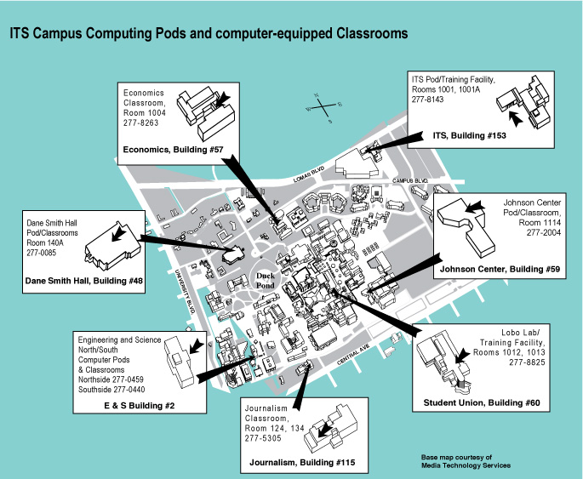
UNM IT (Information Technologies)
http://it.unm.edu/
Working together
Parish Library 24x7
Loner laptops at for 3 hr in building

Slide 7
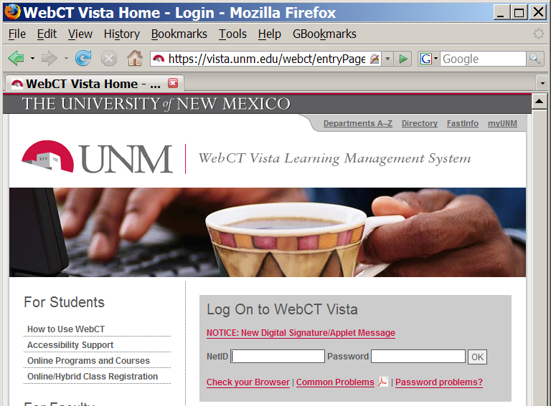
WebCT Login: http://vista.unm.edu/
Internet Browser:
Internet Explorer
Firefox
Safari,
...
UNM NetID

Slide 8
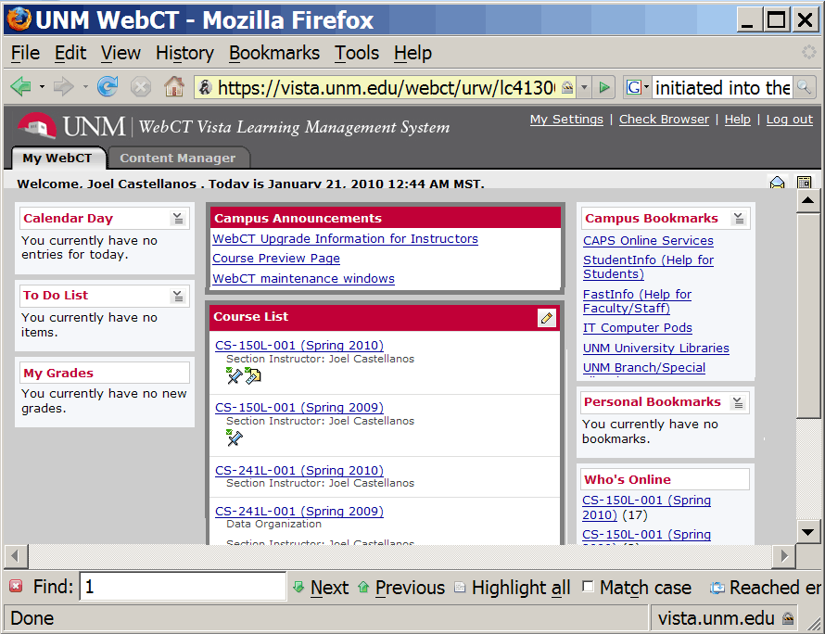
WebCT Login: http://vista.unm.edu/
Course List

Slide 9
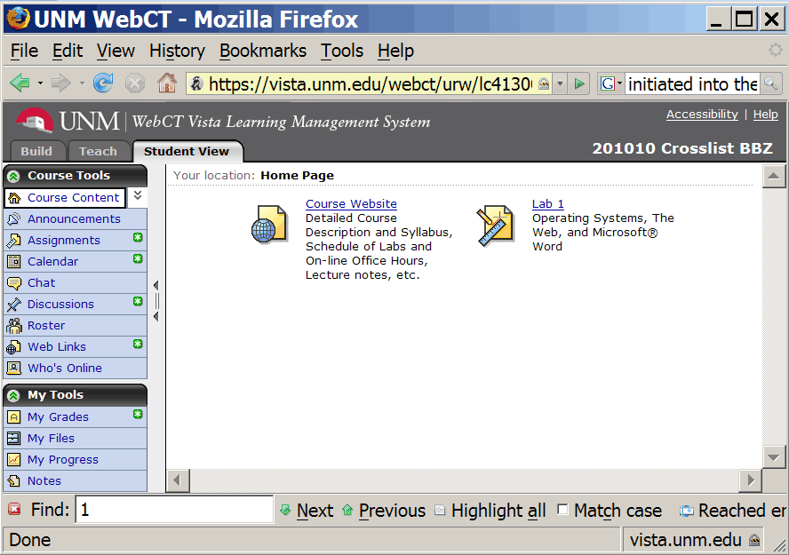
WebCT Login: http://vista.unm.edu/
Course Website
Click on Tabs:
Calendar,
Assignments,
My Grades,
My Files,
...

Slide 10
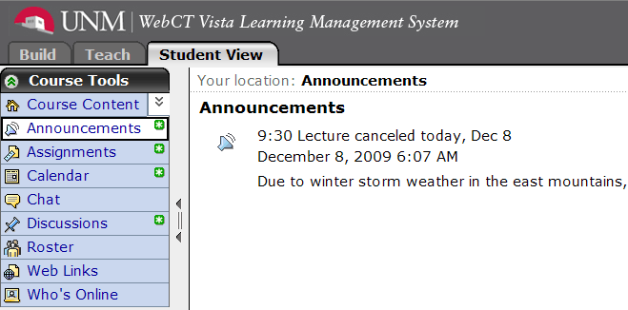
WebCT Announcements

Slide 11
Always Verify WebCT Submissions
When you attach your homework document into in WebCT, do not forget to click Submit.
It is your responsibility to verify that your submit worked.
After submitting, Exit WebCT.
Log back in.
Check that your file is are attached.
Check that the contents of the submission are what you expect them to be.
  Open and examine carefully.
  Make sure you submitted the correct version.
  Up until the assignment due date, you can take back your submission, and resubmit.

Slide 12
WebCT: Take Back Submission

Slide 13
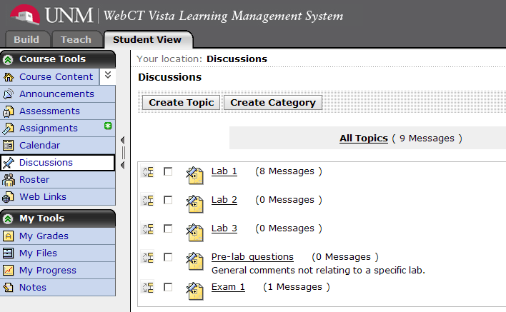
Web CT Discussion

Slide 14
Good Question with Good Title
Subject: lab TA Topic: Lab 1
Author: Lauren Liwski Date: August 25, 2008 7:40 PM
Hello,
My lab TA is named Moe, I accidentally copied his email address wrong I think today during the lab and I was wondering if somebody could give me the correct address? Thanks!
Subject: Re:lab TA Topic: Lab 1
Author: Roxanne Roessner Date: August 26, 2008 6:18 PM
TA emails and lab schedules can be found on the class website: http://cs.unm.edu/~joel/cs150/cs150.html
It should be about the fourth link down!

Slide 15
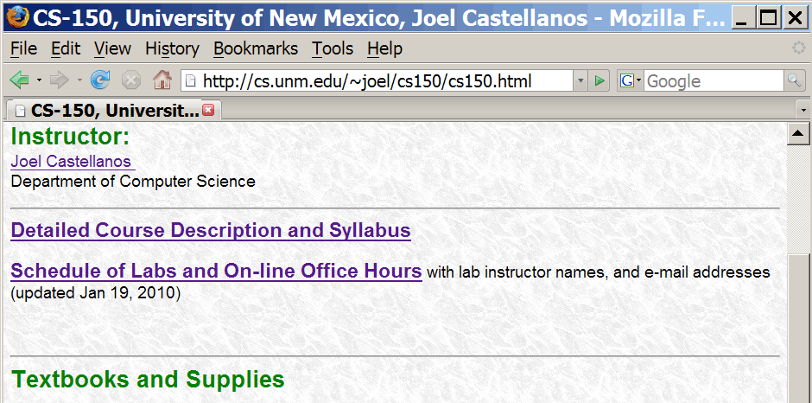
Lab Sections - Dane Smith Hall (DSH), room 141

Slide 16
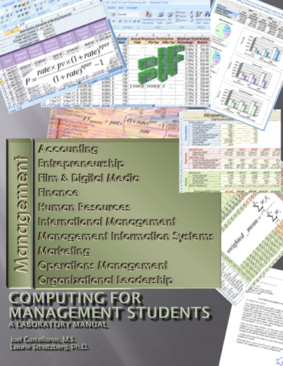
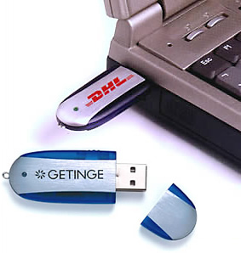
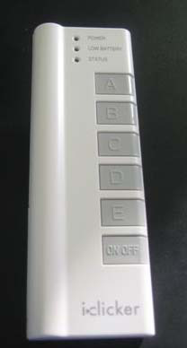

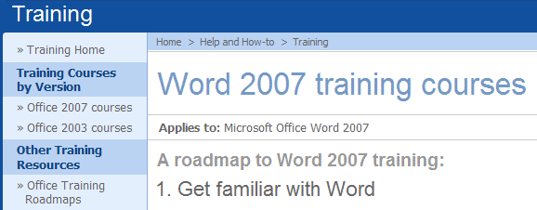
Textbooks and Supplies
Computing for Management Students
Microsoft Online Training Courses
Office Build-in help
USB Flash Drive
I-Clicker
Laptop (optional)

Slide 17
Extras
Headphones/Earbuds for taking Online Tutorials
Money to Print
Absence of non-water beverages

Slide 18
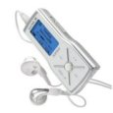
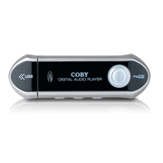
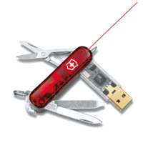
USB Flash Drives
Warning:
Do Not Just Pull Out When Done.
Close all files on USB Flash Drive.
“Safely Remove”: double-click system tray icon.

Slide 19
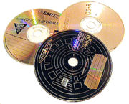
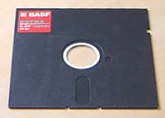
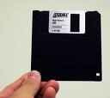
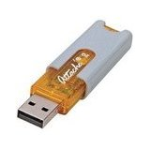
Portable Rewritable Storage Media
Magnetic
5¼-inch DD floppy 1978 360 KB (kilobytes, 1 KB = 1,000 bytes)
5¼-inch HD floppy 1982 1.2 MB (megabytes, 1 MB = 1,000,000 bytes)
3½-inch HD floppy 1987 1.44 MB
Optical
12 cm CD-RW 1997 650 MB
12 cm DVD-RW 2001 4.7 GB (gigabyte = 1,000,000,000 bytes)
12 cm Blu-ray RE 2007 25 GB
Flash Memory (no moving parts)
128 MB, 256 MB, 512 MB, 1024 MB, 2 GB, 4GB, 8GB
1 character of plain text requires 1 byte of storage.
Commonly, a book has 32 lines of text per page, and 70 characters per line.
Thus, 1 GB = about 1,000 books with 500 pages in each book.

Slide 20

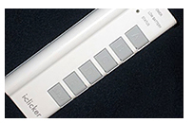
We will use i-clicker for quizzes in lecture only.
We will use i-clicker every lecture.
Quizzes this first week will not count toward your grade.
By next week, your i-clicker needs to be registered with your name.
If you have already registered your i-clicker on the web for a different class, then you do not need to register again.
Register your name as it appears in your UNM NetID.
One i-clicker can be registered to more then one person (as long as no two of them are in the same i-clicker class at the same time).
Work together – help each other – discuss before answering

Slide 21


http://www.iclicker.com/registration/
UNM NetID
(no @unm,edu)
NOT Student ID: i.e. 100838716
8 digit Hexadecimal number: Only decimal digits 0-9 and letters A-F.

Slide 22
Quiz Question #1:
Do you have your i-clicker?
a) Yes – I am ready to go.
b) I bought one from the bookstore, but forgot it.
c) My dog ate it.
d) No – I did not get one yet.
e) What is an i-clicker anyway?

Slide 23
i-clicker Registration Quiz
When I login on "my UNM", the screen says “Welcome Joseph Wood”. Therefore, when I register my i-clicker, I use the name:
a) Joe Wood
b) Joey Wood
c) Joseph Wood
d) Rocko Wood (I like my middle name better)
e) Joseph Losavio (Losavio is my mother's maiden name, and she has taken better care of me than has my dad.)

Slide 24
Practice Question #1
How many 3½-inch HD 1.44 MB floppy disks are required to hold the information that can be stored on a single 1 GB USB Flash Drive?
a) About 5
b) About 10
c) About 50
d) About 100
e) About 700
1.44 MB Floppy
1 GB Flash

Slide 25
Answer
A 1 GB Flash Drive holds 1,024,000,000 bytes
or 1,024 MB
A 1.44 MB Floppy holds 1,440,000 bytes
1,024,000,000/1,440,000 = 1,024/1.440 = 711
1,024 MB / 1.44 MB = 711
1,000,000,000/1,440,000 = 1,000/1.440 = 694

Slide 26
Loner i-clickers
E-mail Moe Alshammari on same day you take the quiz.
malshamm@unm.edu
Subject: CS-150: borrowed i-clicker
Body:
  Animale name (owl, tiger, snake, ...).
  Date of Quiz,
  Your name

Slide 27
Grades
There will be two exams.
All two exams are practical exams: they will be mini-labs administered on computers during your regularly scheduled lab time (50 minutes in length).
Grade Components:
  Labs (12): 45%
  Quizzes (lecture attendance, ~15): 10%
  Exams (2): 45%

Slide 28
Lab Assignments
Lab assignments are posted on WebCT each Monday morning.
Generally, each lab is due by midnight of the following Sunday (11:59PM actually).
To receive credit for a lab, it must be submitted into WebCT.
The WebCT date stamp is the only date used to determine lateness.
A penalty of FIVE POINTS PER DAY will be levied on late assignments.
Every student is given a 100 point late buffer.
Labs more than four weeks late will not be accepted - even for medical excuses.

Slide 29
Lab Attendance
Lab attendance is MANDATORY.
If you are absent, leave early or arrive more than ten minutes late, then you will be marked as absent.
If you need to miss a lab (sick, required sports travel, ...), then make prior arrangements to attend lab at another time during the same week.
To attend a different lab class, both your lab instructor and the instructor of the lab you want to attend must give consent.
Each student is allowed two other times during the semester when a lab may be submitted without having attended the associated lab class.
Once a student has missed two lab classes beyond the first week, any other missed lab class WILL RESULT IN ZERO CREDIT for the associated assignment.
You must attend one of the labs during the week of an assignment to receive credit for it (beyond the first and after you have used your two absences)
This same limit applies to students who register late, students who have medical absences, and students called on military duty.

Slide 30
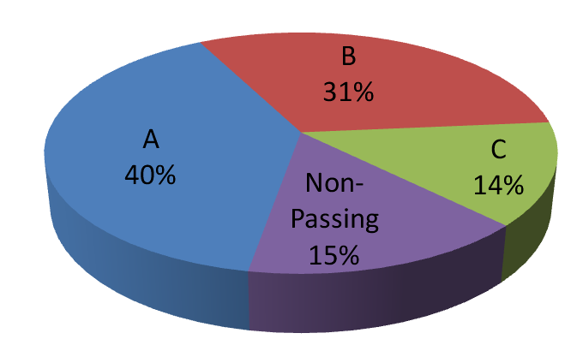
CS-150 Performance: Spring 2010
ANDERSON SCHOOLS OF MANAGEMENT require a minimum grade of “C” and an overall cumulative grade point average of 2.5 on all required pre-admission course work.
CS-150 Spring 2010 Final Grades of students enrolled after first 6 weeks.
Total = 266 students

Slide 31

Academic Honesty
Students are encouraged to help each other on labs through personal interaction and through the WebCT blogs.
There is, however, a difference between helping and cheating. Cheating includes:
  Copying another person’s work,
  E-mailing or giving an electronic version of your work to anyone other than a course instructor.
  Leaving an electronic version of your work on a campus computer.
  Having another person complete any portion of your work.

Slide 32
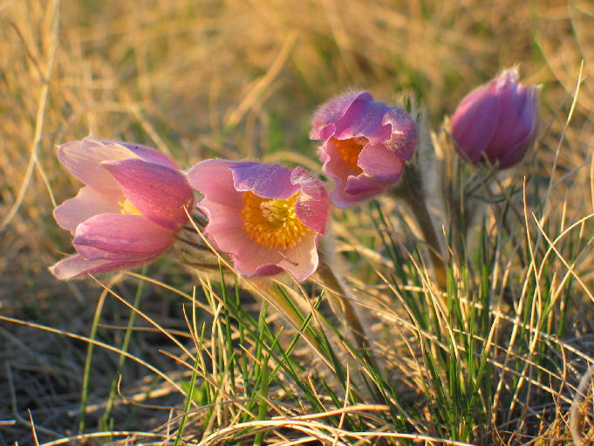
Save, Save As, and Multiple Media
Three things are certain:
Birth, Death, and Lost Data.
Guess which has occurred.
-- Error Message by David Dixon
Save often.
Use “Save As...” to save progressive versions with different names.
Save on more than one media:
  Save on two flash drives.
  Copy Flash drive to home Hard Disk.
  Periodically, burn files on home hard disk to CD or DVD.

Slide 33
Mac Users
There is a discussion forum on WebCT devoted to you.
I am a Mac user but not an Office-user on Mac, the Mac forum is your best source of help.
This course is centered around using Microsoft Office 2003/2007 on Windows
You should be able to complete all assignments using Microsoft Office 2008
Put aside time to learn the differences, if only for the exams.

