Slide 1
CS-150L Computing for Business Students Lab 6: Charts, Charts, and More Charts
Instructor:
Matthew Barrick
e-mail: barrick@cs.unm.edu
www.cs.unm.edu/~barrick
Office: Farris Engineering Center (FEC) room 106

Slide 2
Schedule
i-clicker Quiz 1: Grades for newly registered i-clickers posted.
i-clicker Quiz 1 DEADLINE: no updates will be made to quiz 1 after Oct 11.
Week of Oct 6: Lab 7 - Excel Charts
Week of Oct 11: No Lab, Review + Fall Break
(Lab is optional this week!)
Week of Oct 18: Midterm exam - DURING Lab class.

Slide 3
Lab 7: Excel Charts
Internet research of company income statement. This is not just busy work but addresses one of the New Mexico Collegiate Business Articulation Consortium required objectives for this course.
Bar Charts
Column Charts
3-D Clustered Column Chart
Pie Charts
Chart Format Customization
Chart Data Customization

Slide 4
Excel Error: Value
Column C shows the equations as text used in B2 and B3.
Why does B3 show an error?
The table above is an active worksheet: Click to open.

Slide 5
Quiz: Weighted Average
Which equation can be filled right from cell C6, to correctly calculate the weighted average in cells C6:E6?
a) =($C$2*B2+$C$3*B3+$C$4*B4+$C$5*B5)/SUM($B$2:$B$5)
b) =(C2*$B$2+C3*$B$3+C4*$B$4+C5*$B$5)/SUM($B$2:$B$5)
c) =($C$2*B2+$C$3*B3+$C$4*B4+$C$5*B5)/SUM(B2:B5)
d) =AVERAGE(C2:C5)
e) =AVERAGE(C2:C5)/SUM(B2:B5)

Slide 6
Quiz: Interest
The simple interest on the balance in cell B4 over a period of days given in cell A4 can be calculated by?
a) =$D$1*B4
b) =$D$1 + B4 + A4
c) =$D$1*B4*A4
d) =$D$1 + B4*A4
e) =$D$1*B4 + A4

Slide 7
Income Statement: Exxon Mobil Corp

Slide 8
Income Statement
Total Revenue: Total sales revenue, interest on investments, and other revenue for a particular period.
Total Expenses: All expenses including meterial costs, salaries, rentals, captial deperciation, research and development. Does not include taxes, or stock dividends.
Total Profit: This is also called Operating Income
= (Total Revenue) – (Total Expenses)

Slide 9
Pie Charts
Useful when the data items are disjoint (non-overlapping) and together form a logical whole.
Title
Legend
Background
Border
Data Labels

Slide 10
Pie Chart Requirements
Placing this data in a pie chart implies that together they form some meaning full whole. Thus they need to:
Draw from the same costumer base.
Provide similar products or services.
Taken together, provide the vast majority of those products or services to all of the given costumer base.

Slide 11
Quiz: Pie Chart
Which of these data sets could be well represented as a pie chart?
a) Total Profit & Total Expenses
b) Total Revenue & Total Expenses
c) Total Revenue in 2006 & Total Revenue in 2007
d) Total Expenses in 2006 & Total Expenses in 2007
e) Total Taxes & Total Capital Investments

Slide 12
Format Patterns
All sections selected
One Section Selected

Slide 13
Format Data Labels

Slide 14
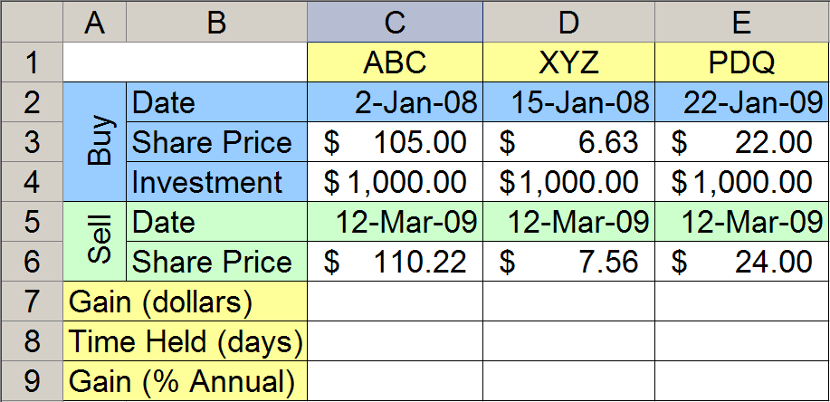
Return on Investment
Which investment was the best?
What equation should be entered in cell C7 and filled across through E7?

Slide 15
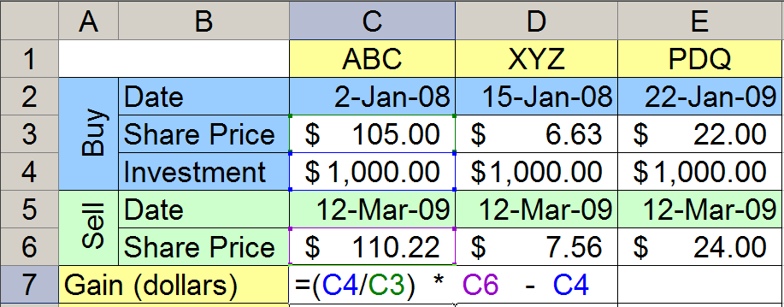
Stock Investment Gain (dollars)
Number of Shares Purchased
Sale Value

Slide 16
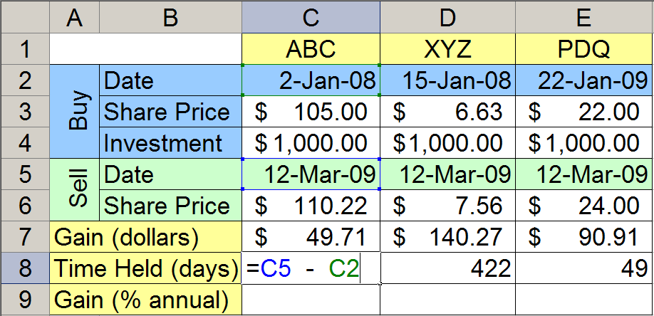
Time Held (days)

Slide 17
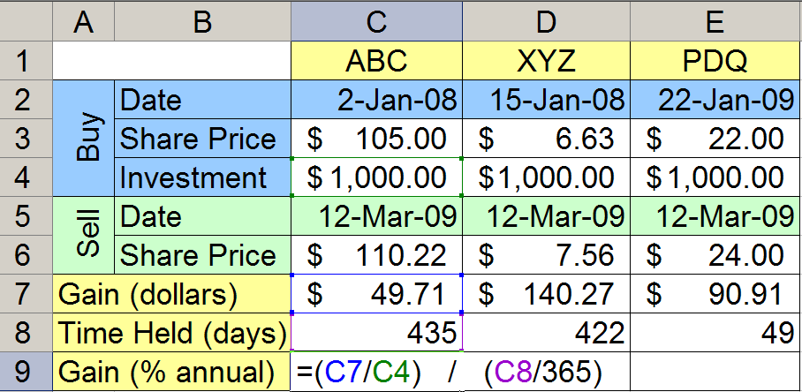
Annual Percentage Gain
Percent Gain
Number of years

Slide 18
Chart Comparison
Both charts show stock price at market close once per quarter from 1/1/2005 through 10/1/2007.
Which company was the better investment?
Which was more volatile?
Company A
Stock Price
Company B
Stock Price

Slide 19
Chart Comparison
Both charts show stock price at market close once per quarter from 1/1/2005 through 10/1/2007.
Which company was the better investment?
Which was more volatile?
Company A
Stock Price
Company B
Stock Price

Slide 20
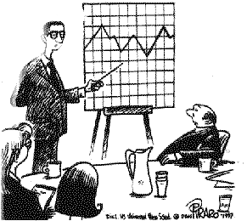
BIZARRO – by Dan Piraro
... and here's a chart that shows what you might see if you looked at a mountain range through a tennis racket.

Slide 21
Quiz: Chart Axis Format
What settings were used in the chart:
a) Minimum=0.0, Maximum=1.0, Major Unit=0.1
b) Minimum=0.1, Maximum=0.25, Major Unit=0.25
c) Minimum=0.5, Maximum=1.0, Major Unit=0.5
d) Minimum=0.5, Maximum=1.0, Major Unit=0.25
e) Minimum=0.1, Maximum=1.0, Major Unit=0.5

Slide 22
Quiz: Chart Comparison
Which of these two stocks received the higher rate of return during the ten year period from 1998 through 2008?
a) The one on the top.
b) The one on the bottom.
c) They are both about the same.
Stock Share Price at close of first Market day of year.

Slide 23
Quiz: Interest
Cell A1 contains the APR of an account that pays simple interest.
Cell A2 contains the original balance on the account.
Cell A3 contains the number of months the account has been accruing interest.
What is the current balance of the account?
a) A2+A1*A2*A3
b) A2+A1+A3
c) A2+(A1/12)+A3
d) A2+(A1/12)+A2*A3
e) A2+(A1/12)*A2*A3

Slide 24
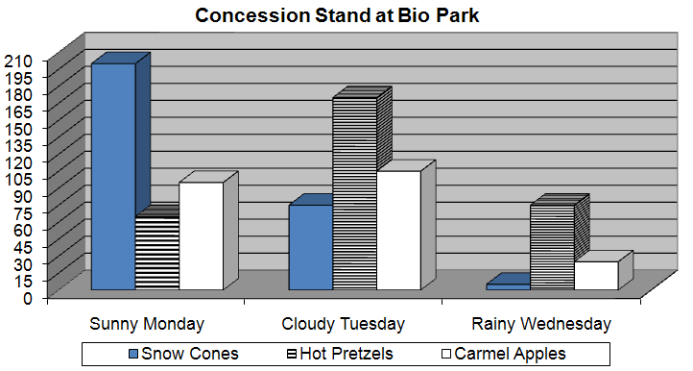
3D Clustered Column Chart
Three data series: Snow Cones, Hot Pretzels, Carmel Apples
Three Clusters: Monday, Tuesday, Wednesday

Slide 25
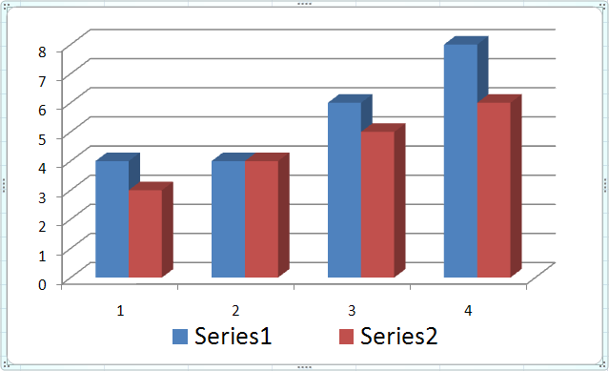
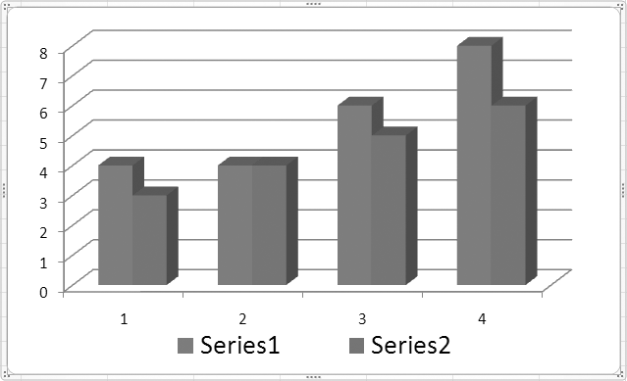
Problems with Fill Colors on a Chart
In a Cluster Column Chart, using a different color for each series is great except when...
The chart is printed on a black-and-white printer.
The person viewing the chart is color blind.

Slide 26
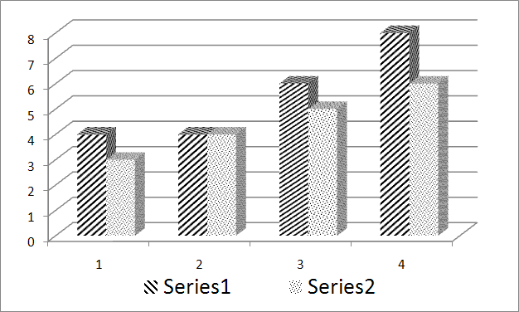
Chart Pattern Fills
Pattern fills work best when color is not available.

Slide 27
Chart Pattern Fills: Procedure Outline
Create a chart.
Select one series by clicking on a pie slice or bar of that series. If you want to change the pattern of only one data point in the series, then click a second time on that slice or bar.
Open the Visual Basic Editor. This can be done by pressing ALT+F11 or by selecting Visual Basic from the Developer tab.
From the Visual Basic Editor, open the Immediate Window by pressing CTRL+G or by selecting “Immediate Window” from the Visual Basic Editor “View” menu.
In the immediate window, enter the following command: selection.fill.patterned(n)

Slide 28
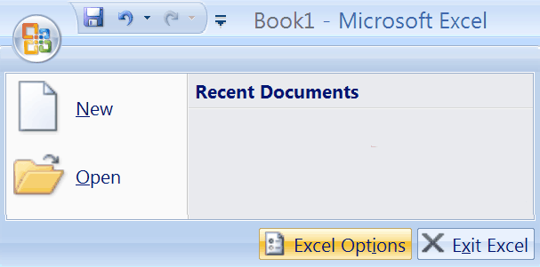
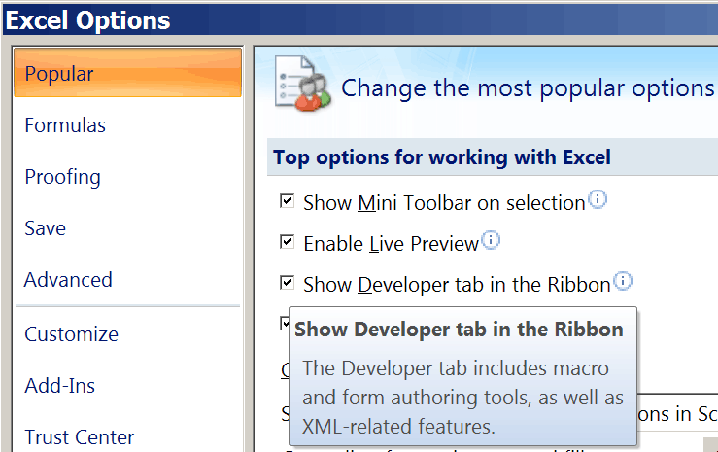
Excel’s Developer Tab
By default, Excel’s Developer Tab is not shown in the Ribbon.
Excel Options
“Show Developer tab in the Ribbon”

Slide 29
Chart Pattern Fills: Select One Series
Select one series by clicking on a pie slice or bar of that series. If you want to change the pattern of only one data point in the series, then click a second time on that slice or bar.

Slide 30
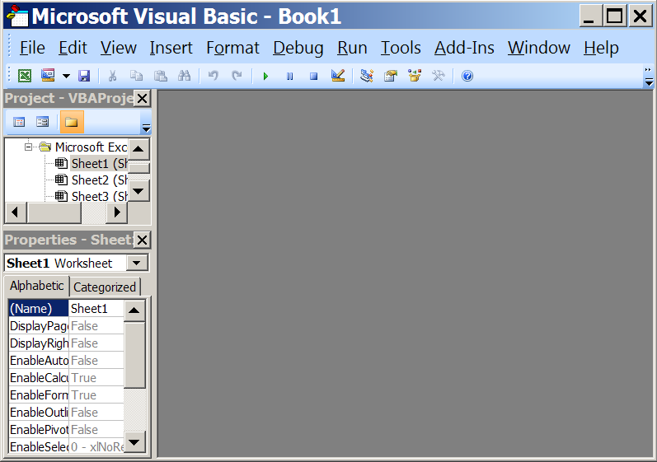
Chart Pattern Fills: Visual Basic Editor
Open the Visual Basic Editor. This can be done by pressing ALT+F11 or by selecting Visual Basic from the Developer tab.

Slide 31
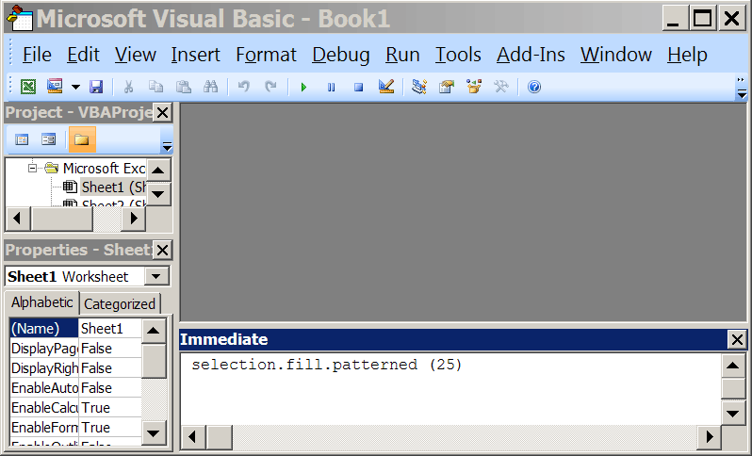
Chart Pattern Fills: Immediate Window
From the Visual Basic Editor, open the Immediate Window by pressing CTRL+G or by selecting “Immediate Window” from the Visual Basic Editor “View” menu.

Slide 32
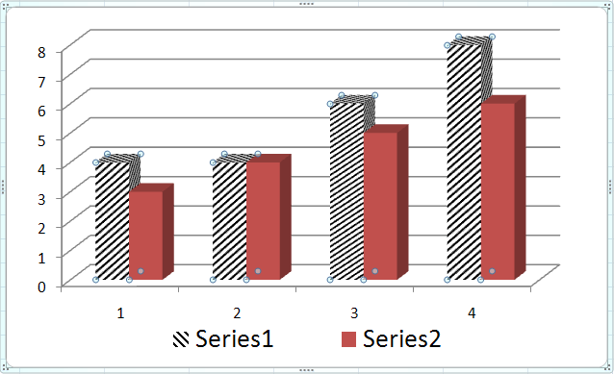
selection.fill.patterned(n)
In the immediate window, enter the following command: selection.fill.patterned(25)
Different values of n give different patterns.

