Slide 1
CS-150 Computing for Business Students Financial Forecast
Instructor:
Matthew Barrick
e-mail: barrick@cs.unm.edu
www.cs.unm.edu/~barrick
Office: Farris Engineering Center (FEC) room 106

Slide 2
Quiz: Syntax
Which of the following uses Correct Syntax?
a) =IF(WEEKDAY(C3)=1,C3+1,C3)
b) =IF(WEEKDAY(C3=1),C3+1,C3)
c) =IF(WEEKDAY(C3=1,C3+1),C3)
d) =IF(WEEKDAY(C3)=(1,C3+1,C3))
e) =IF(WEEKDAY(C3=1,(C3+1,C3))

Slide 3
Question From an Articulate Student
Dear Professor, I have an equation that in my mind makes complete and perfect sense, but for some reason Excel is not cooperating with me. My equation in Cell M2, dragged down works perfectly in all cells except for where the Employee Contributions are <13% or >=5%.
...
Isaac Ketcham Attachment: CS150-Lab9-Isaac-Ketcham(1).xls (433Kbytes)

Slide 4
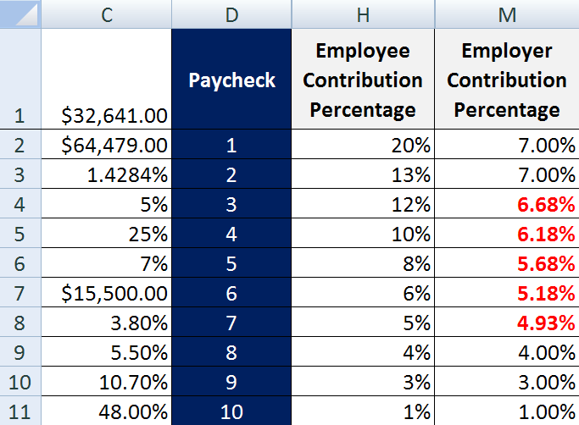
Employer Contribution Percentage
=IF(H2<=$C$4, H2, IF(H2>=13%, 7%, (H2-$C$4) * 25% + $C$4) )
Case 3: Should be 5.25%
C4 does not contain the value 5%. The value in C4 is 4.90%
Case 1: Should be 5.00%

Slide 5
If Excel Were a Car...
...It would crash two or three times per day for no apparent reason. The driver is often hurt, but the car itself receives no permanent damage. You'd just accept this fact, restart the car, and begin your trip again.
...The oil, engine, gas and alternator warning lights would be replaced by a single warning light: "#NAME?"
...Before engaging, the airbag system would display a message, "Are you sure?"
-- John Walkenbach: http://spreadsheetpage.com/

Slide 6
Quiz: Student Loan
A student loan is taken out for $5200.00 on 3/1/2008. The loan has an APR of 4.25%. There are no payments due for 4 years. Starting on the lone date, the loan balance accrues interest compounded monthly. Which equation entered in B3 can fill down through B5 to correctly give the balance of the loan each month?
a) = B2*$E$2
b) = B2*$E$2/12
c) = B2 + B2*($E$2/12)
d) = $E$1 + $E$1*($E$2/12)
e) = E1 + E1*($E$2/12)

Slide 7
Financial Forecast Terms
Financial Forecast can refer to an annual projection of income and expenses for a company, division or department.
Fixed Costs: Insensitive to annual performance.
Variable Cost or Marginal Costs: Sensitive to annual performance
Unit Sale Price: Price one item is sold for.
Unit Manufacturing Cost: Cost making one item.
Gross Revenue : Total Income before subtracting costs.
Earnings or Profits: (Gross Revenue – Total Costs).

Slide 8
Financial Forecast - Assumptions
Fixed costs, such as personnel and facility are not included in the unit cost of the printer and ink cartridge.
What is odd about some of the values in this table?

Slide 9
Financial Forecast - Income
Ref
=
Ref
=
Ref
=
Ref
=
=
Units Sold and Sale Price:
2009: Cell reference to assumption.
2010: (2009 value) + (2009 value * Percent Increase).
2011: Fill Right from 2010.
Gross Revenue:
2009: Revenue from printers + Revenue from ink.
2010: Fill Right from 2009.

Slide 10
Income Example
Given the 2009 values above, what is the value of Gross Revenue in 2009?
Gross Revenue = Printer Revenue + Ink Revenue
= C2*C4 + C3*C5
= $2,400.00

Slide 11
Quiz: Gross Revenue
The best equation to enter in cell C6 is
=C2*C3 + C4*C5
=$C$2*C3 + $C$4*C5
=C2*C4 + C3*C5
=C2*C4 + $C$3*$C$5
=$C$2*C4 + $C$3*C5

Slide 12
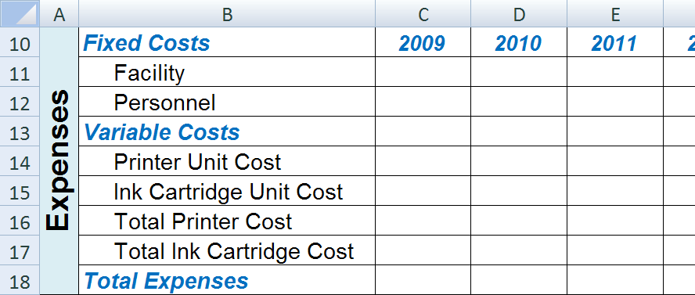
Financial Forecast - Expenses
Within a single year, production facility costs and personnel costs are relatively insensitive to the number of items sold.
Fixed costs can change from year to year.

Slide 13
Quiz: Fixed verses Marginal Costs
Travis and Evan are planning to start an on-site, computer repair service company. They imagine their primary expenses will be: a custom utility van, gasoline, tools, replacement computer parts, insurance, and their salaries. Which two of these are most likely to be Marginal Costs?
The van and the gasoline.
Their salaries and the insurance.
Their salaries and the tools.
The van and the tools.
The gasoline and replacement computer parts.

Slide 14
Total Printer Manufacturing Cost
Both tables have Printer Units Sold.
Does it matter which of these is referenced in the equation to find the Total Printer Manufacturing Cost?

Slide 15
Earnings Before Taxes (the bottom line)
How is this calculated?
What justification for any negative numbers might the presenter of this financial forecast give to a prospective investor?

Slide 16
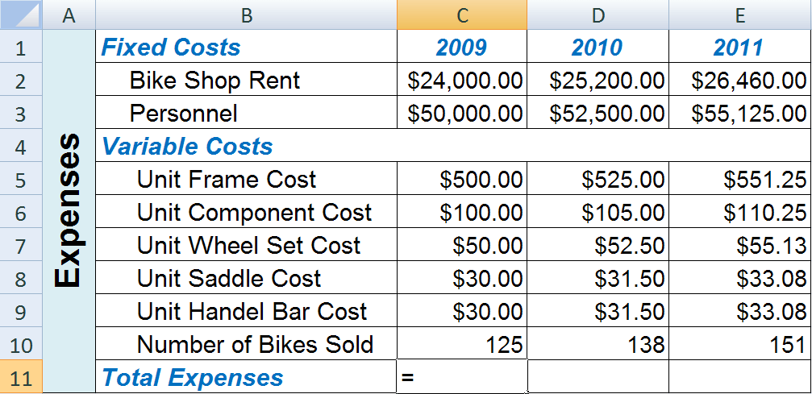
Quiz: Total Expenses
Which equation is the best choice for cell C11?
=C2 + C3 + C5 + C6 + C7 + C8 + C9 + C10
=C2 + C3 + (C5 + C6 + C7 + C8 + C9)*C10
=(C2 + C3 + C5 + C6 + C7 + C8 + C9)*C10
=(C2 + C3 + C5 + C6 + C7 + C8 + C9)*$C$10
=($C$2 + $C$3 + C5 + C6 + C7 + C8 + C9)*$C$10

Slide 17
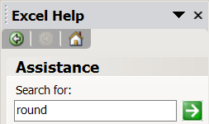
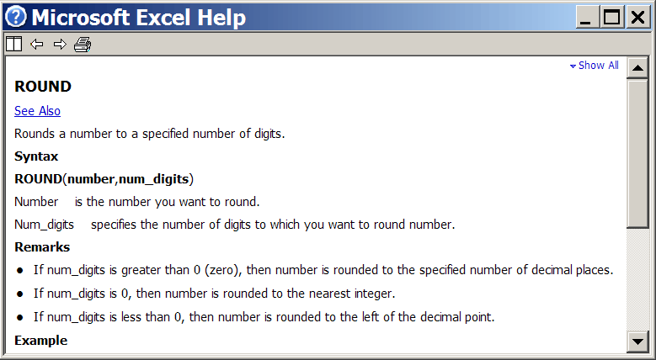
Round(value, digits)

Slide 18
Quiz: Round()
B1, C1, D1 and E1 show the equations as text used in B2, C2, D2 and E2.
Cells B2:E2 are formatted as currency with no decimal places.
What values will display in B2, C3, D2, and E2?
$7, $8, $77, $77
$7, $8, $70, $77
$7, $8, $70, $80
$8, $8, $77, $77
$8, $8, $77, $80

Slide 19
VLOOKUP(lookup_value, table, colunm_num)
Active Excel Table
Shipping Cost (fill down from D2):
=VLOOKUP(B2, $H$2:$J$4, C2 )

Slide 20
VLOOKUP(lookup_value, table, colunm_num)
The V in VLOOKUP stands for vertical.
The lookup_value is searched for in the first column of the table.
VLOOKUP finds the row of the table containing the lookup_value.
If lookup_value is not in the table, then VLOOKUP finds the row before the first table number greater than lookup_value.
If lookup_value is greater than all the first column table numbers, then VLOOKUP finds the last row of the table.
VLOOKUP returns the value in the found row and column_num of the table.
The first column of the table MUST be in increasing order.

Slide 21
Deeply Nested IF() Returns Letter Grade
It is necessary, in the nesting, that
IF(B2<$A$12... is before
,IF(B2<$A$13...

Slide 23
Letter Grade by IF and VLOOKUP
Active Excel Table
=VLOOKUP(B2, $F$2:$G$6, 2)

Slide 24
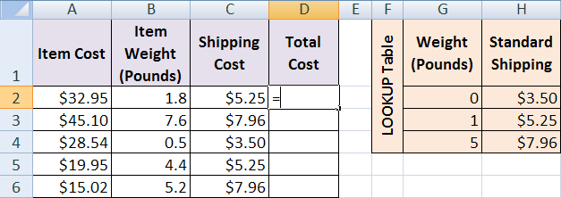
Quiz: Total Cost
Which is the best Excel equation to enter in cell D2?
a) =A2 + $B$2 + C2
b) =A2 + B2 + $C$2
c) =A2 + C2
d) =$A$2 + C2
e) =A2 + $C$2

Slide 25
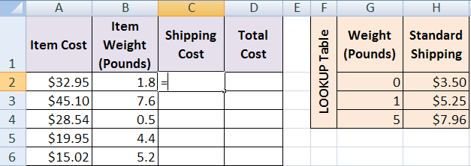
Quiz: Shipping Costs using IF()
Which is the best Excel equation to enter in cell C2?
a) =IF(B2<G3, H2, IF(B2<G4, H3, H4))
b) =IF(B2<$G$3, $H$2, IF(B2<$G$4, $H$3, $H$4))
c) =IF(B2>$G$2, $H$2, IF(B2>$G$3, $H$3, $H$4))
d) =IF(B2>$G$2, $H$3, IF(B2>$G$2, $H$3, $H$4))
e) =IF(B2<$G$2, $H$2, IF(B2<$G$3, $H$3, $H$4))

Slide 26
Quiz: Shipping Costs: VLOOKUP()
Which is the best Excel equation to enter in cell C2?
a) =VLOOKUP(A2, G2:H4, 2)
b) =VLOOKUP($A$2, $G$2:$H$4, 2)
c) =VLOOKUP(B2, G2:H4, 2)
d) =VLOOKUP($B$2, $G$2:$H$4, 2)
e) =VLOOKUP(B2, $G$2:$H$4, 2)

Slide 27
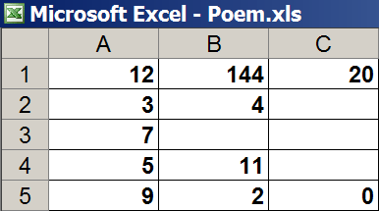
Excel Poem by John Walkenbach
=((A1+B1+C1+(A2*SQRT(B2)))/A3)+(A4*B4)=(A5^B5)+C5
A dozen, a gross and a score,
Plus three times the square root of four,
Divided by seven,
Plus five times eleven,
Equals nine squared and not a bit more.

